Slide 1
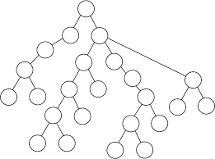
Non-linear Data Structures
Tree is another very useful data structure in which elements are appearing in a non-linear fashion, which requires a two dimensional representation.

Slide 2
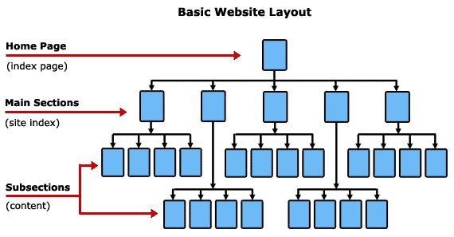
Applications/Real time examples
Webpage Layout

Slide 3
Director
Dean
(administration)
Dean
(academics)
Dean
(research)
HOD (cse)
HOD (ce)
HOD (it)
HOD (me)
HOD (ec)
Teaching
Non- teaching
Teaching
Non- teaching
F1 F2 F3 NF1 NF2
F1 F2 F3 NF1 NF2

Slide 4
TREE
Finite collection of special data items called nodes
Nodes of the tree are arranged in hierarchical structures to represent the parent-child relationship
No restriction on the number of children for a node
1
2
3
3
4
5
6
7
7
7

Slide 5
Tree Applications
Binary Search Trees(BSTs) are used to quickly check whether an element is present in a set or not.
Heap is a kind of tree that is used for heap sort.
A modified version of a tree called Tries is used in modern routers to store routing information.
Most popular databases use B-Trees and T-Trees, which are variants of the tree structure we learned above to store their data
Compilers use a syntax tree to validate the syntax of every program you write.

Slide 6
Tree - Terminologies

Slide 7
Basic Components
Node (or Vertex): The fundamental unit of the tree, which stores data and connections to other nodes.
Edge: The connecting link between any two nodes. In a tree with $N$ nodes, there will be exactly $N-1$ edges.
Root: The topmost node of the tree. It is the only node with no parent. Every tree must have exactly one root.
Leaf Node (or External Node/Terminal Node): A node that has no children. These are the end points of the tree branches.
Internal Node (or Non-Terminal Node): Any node that has at least one child. This includes the root if the tree has more than one node.
👨‍👩‍👧‍👦 Node Relationships
Parent: The immediate predecessor of a node (the node directly above it). Every node except the root has exactly one parent.
Child: The immediate successor of a node (the node directly below it). A parent can have one or more children.
Siblings: Nodes that share the same parent.
Ancestor: Any node along the path from the root to a specific node, including the parent, grandparent, and so on.
Descendant: Any node that can be reached by continually moving from a parent to a child from a specific node.
📏 Metrics and Structure
Path: The sequence of nodes and edges from one node to another. The length of a path is the number of edges it contains.
Subtree: A portion of the tree structure that can be viewed as an entire tree itself, consisting of a node and all of its descendants.
Degree:
  Degree of a Node: The total number of children that node has.
  Degree of a Tree: The maximum degree among all nodes in the tree.
Level: The position of a node in the hierarchy, defined by the number of edges from the root to that node plus one (often, the root is at Level 1 or Level 0).
Depth: The number of edges from the root to the node. The depth of the root node is 0.
Height:
  Height of a Node: The length of the longest path from that node down to a leaf node.
  Height of a Tree: The height of its root node.

Slide 8
Types of trees
General Tree
Binary Tree
Binary Search Tree
AVL Tree
Expression Tree
Heap

Slide 9
General Tree
Definition: The most fundamental type of tree. There are no restrictions on the degree (number of children) of a node.
Key Feature: Any node can have zero or more children.
Example Use: Representing file systems (a folder can contain many files/subfolders) or organizational charts.

Slide 10
Binary Tree
Definition: A tree data structure in which each node can have at most two children (zero, one, or two). These children are typically designated as the left child and the right child.
Key Feature: The maximum degree of any node is $\mathbf{2}$.
Example Use: Basis for more specialized structures like BSTs and Heaps.
Binary Search Tree (BST)
Definition: A special type of Binary Tree where the nodes are ordered based on their values.
Key Feature: For every node:
  All values in its left subtree are less than the node's value.
  All values in its right subtree are greater than the node's value.

Slide 11
AVL TREE
Definition: A self-balancing Binary Search Tree (BST). It's the first such tree structure invented.
Key Feature: For every node, the height difference (or balance factor) between its left and right subtrees must be $\mathbf{-1}$, $\mathbf{0}$, or $\mathbf{1}$.
Mechanism: It automatically performs rotations (like single or double rotations) to maintain this balance after insertion or deletion, ensuring that the tree never becomes skewed (like a linked list).
Expression Tree
Definition: A specific kind of Binary Tree used to represent an algebraic expression.
Structure:
  Internal nodes are operators (like $+$, $-$, $*$, $/$).
  Leaf nodes are operands (like numbers or variables: $x$, $y$, $5$).
Advantage: Can be used to evaluate the expression easily using different traversal methods (e.g., inorder traversal yields the infix expression).
Example: A tree representing the expression $\mathbf{(A + B) * C}$. The root would be $*$, its left child would be the subtree for $(A+B)$, and its right child would be $C$.

Slide 12
Heap
Definition: A specialized complete Binary Tree that satisfies the Heap Property.
Heap Property:
  Max-Heap: For every node, the value of the parent is greater than or equal to the values of its children. The largest element is always at the root.
  Min-Heap: For every node, the value of the parent is less than or equal to the values of its children. The smallest element is always at the root.
Implementation: Heaps are commonly implemented using a simple array, which allows for very efficient access to parent/child nodes.
Example Use: Implementing Priority Queues and the Heapsort algorithm.

Slide 13
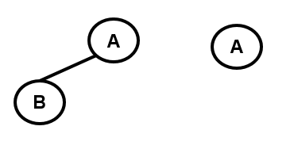
BINARY TREE: Definition
A binary tree T is a finite set of nodes such that
  T is empty or T contains a specially designated node called the root
  The remaining nodes of T are partitioned into two disjoint sets T1 and T2 where each of these sets is a tree [Tn where n=0,1 or 2 ]
T1 and T2 are called the subtrees of the root- Left and Right subtrees
1
2
3
4
5
6
7

Slide 14
Terminologies
Binary TREE
a tree which is either empty or each node can have maximum 2 children
each node can have either 0 children, 1 child or 2 children
Leftchild - Node on the left of the parent
Rightchild - Node on the right of the parent
1
leftchild
2
3
rightchild
4
5
6
7

Slide 15
Terminologies
Binary TREE
Leftsubtree - Tree on the left of the parent
Rightsubtree - Tree on the right of the parent
1
2
3
4
5
6
7

Slide 16
Terminologies
Binary TREE
Leftsubtree - Tree on the left of the parent
Rightsubtree - Tree on the right of the parent
1
leftsubtree
2
3
4
5
6
7

Slide 17
Terminologies
Binary TREE
Leftsubtree - Tree on the left of the parent
Rightsubtree - Tree on the right of the parent
1
2
3
rightsubtree
4
5
6
7

Slide 18
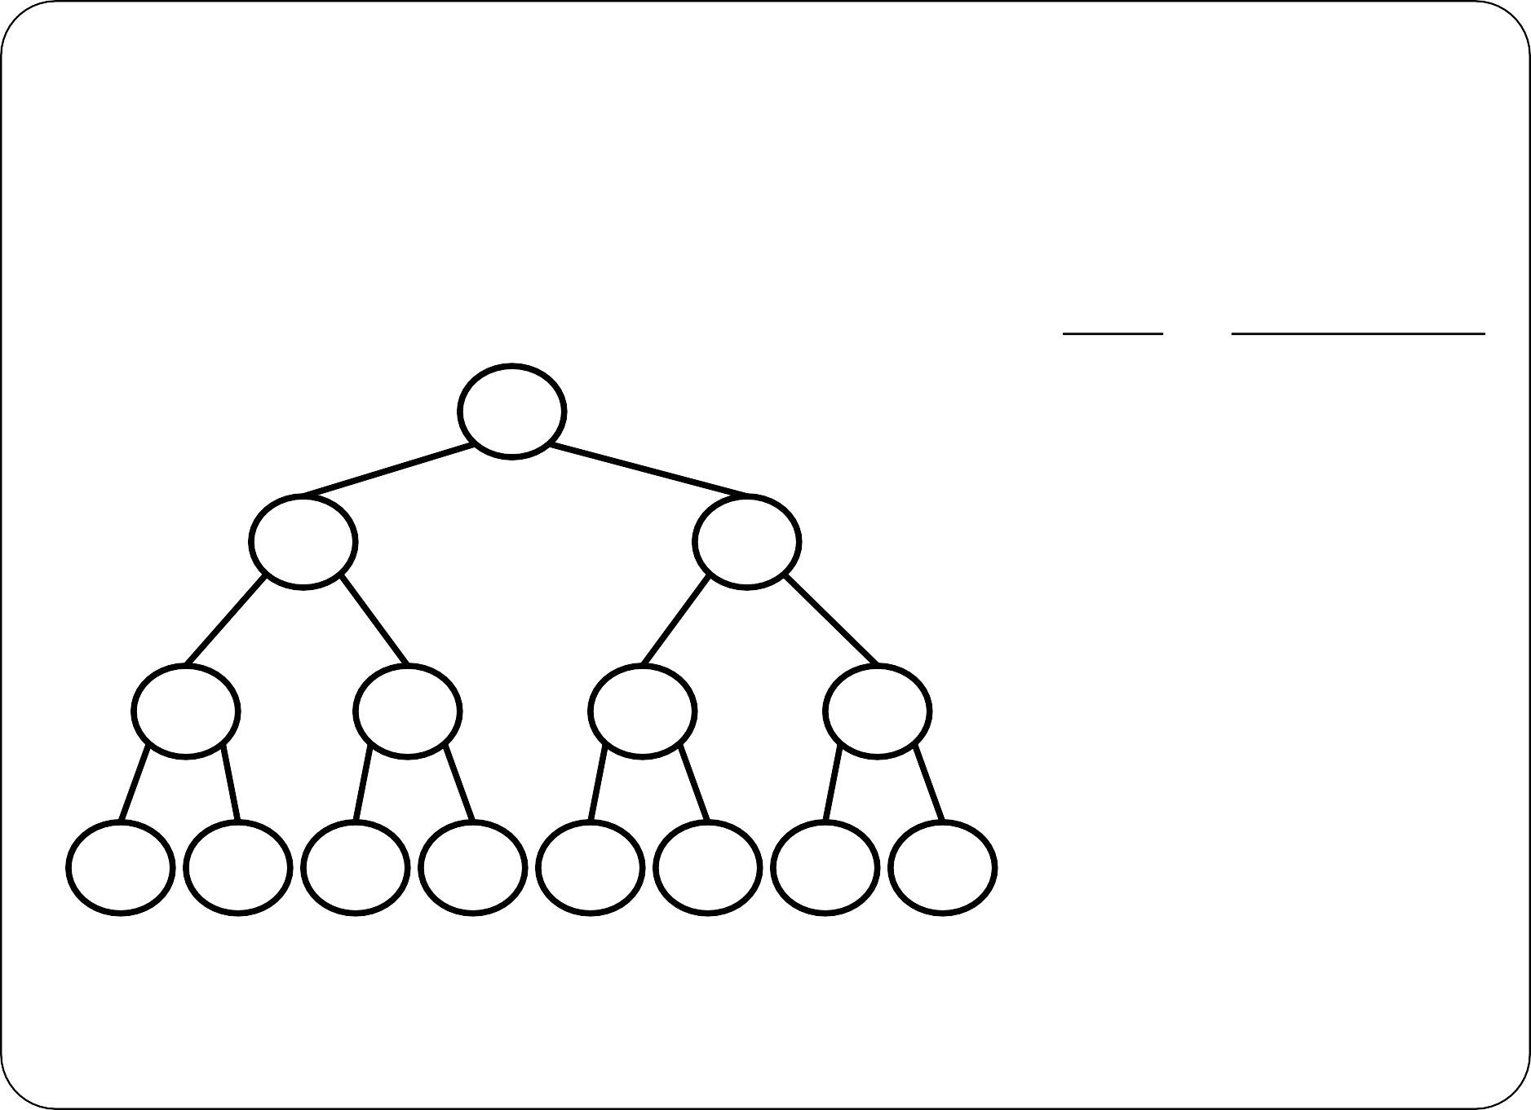
Binary Tree -Properties
The maximum number of nodes on level i of a binary tree is 2^{i}, i>=0
Level
No. of Nodes
1
0
A
B
C
1
2
D
E
F
G
2
4
H
I
J
K
L
M
N
O
3
8
i
₂i

Slide 19
Binary Tree -Properties
The maximum number of nodes in a binary tree of height h is 2^{h+1}-1, h≥0
Height
No. of Nodes
1
0
A

Slide 20
Binary Tree -Properties
The maximum number of nodes in a binary tree of height h is 2^{h+1}-1, h≥0
Height
No. of Nodes
1
0
A
B
C
1
3

Slide 21
Binary Tree -Properties
The maximum number of nodes in a binary tree of height h is 2^{h+1}-1, h≥0
Height
No. of Nodes
1
0
A
B
C
1
3
D
E
F
G
2
7

Slide 22

Binary Tree -Properties
The maximum number of nodes in a binary tree of height h is 2^{h+1}-1, h≥0
Height
No. of Nodes
1
0
A
B
C
1 | 3
2 | 7
3 | 15
D
E
F
G
H
I
J
K
L
M
N
O

Slide 23
Binary Tree -Properties
The maximum number of nodes in a binary tree of height h is 2^{h+1}-1, h≥0
Height
No. of Nodes
1
0
A
B
C
1
3
D
E
F
G
2
7
H
I
J
K
L
M
N
O
3
15
h
₂h+1₋₁

Slide 24
Binary Tree -Properties
For any nonempty binary tree, T, if n₀ is the number of leaf nodes and n₂ the number of nodes of degree 2, then n₀=n₂+1
A
B
C
D
E
F
G
J M
Number of nodes with degree 2 = n₂ = 3
Number of leaf nodes = n₀ = 4

Slide 25
Binary Tree -Properties
Minimum number of nodes possible in a binary tree of height h is h+1
A
B
C
D
Consider this skewed binary tree
Here, height of the tree = 3
Minimum number of nodes possible = 4

Slide 26
Binary Tree -Properties
For any non empty binary tree, if n is the number of nodes and e is the number of edges then n=e+1
A
B
C
D
E
F
G
Number of nodes = n = 7
Number of edges = e = 6

Slide 27
REPRESENTATIONS OF BINARY TREE
Linear or sequential representation
Linked or pointer representation

Slide 28
REPRESENTATIONS OF BINARY TREE
Linear or sequential representation
A block of memory for an array is allocated before storing the actual tree in it
Once memory is allocated, the size of the tree is restricted as permitted by the memory
In this representation, the nodes are stored level by level, starting from the zero level where only the root node is present
A[0] | 1
A[1] | 2
A[2] | 3
A[3] | 4
A[4] | 5
A[5] | 6
A[6] | 7
1
2
3
4
5
6
7

Slide 29
REPRESENTATIONS OF BINARY TREE
Linear or sequential representation
Following rules can be used to decide the location of any node
1. The root node is at index 0
A[0] | 0
A[1] | 1
A[2] | 2
A[3] | 3
A[4] | 4
A[5] | 5
A[6] | 6
For any node with index ,
  parent (i) is at (i – 1)/2
  Left child of i is at 2i+1
  Right child of i is at 2i + 2
0
1
2
3
4
5
6

Slide 30
REPRESENTATIONS OF BINARY TREE
Linear or sequential representation
Left child of i is at 2i+1 :
If 2i + 1 > n – 1, then the node does not have a left child
Eg: i=3 , then 2i+1 = 7, but 7>n-1 → no left child Right child of i is at 2i + 2:
If 2i + 2 > n – 1, then the node does have a right child
A[0] | 0
A[1] | 1
A[2] | 2
A[3] | 3
A[4] | 4
A[5] | 5
A[6] | 6
0
– Eg: i=3 , then 2i+2 = 8, but 8>n-1 → no right child
1
2
3
4
5
6

Slide 31








REPRESENTATIONS OF BINARY TREE
A[0] | 0
A[1] | 1
A[2] | 2
A[3] | 3
A[4] | 4
A[5] | 5
A[6] | -
A[7] | 7
A[8] | -
A[9] | -
A[10] | -
A[11] | 11
A[12] | -
A[13] | -
A[14] | -
Linear or sequential representation
0
1
2
3
4
5
6
7
8
9
10
1
1
1
2
1
3
1
4

Slide 32
Sequential Representation
[1]
[2]
[3]
[4]
[5]
[6]
[7]
[8]
[9]
A
B
C
D
E
F
G
H
I
Wastage of space
Insertion/deletion problem
[0]
[1]
[2]
[3]
[4]
[5]
[6]
[7]
[8]
-> [15]
A
B
--
C
--
--
--
D
--
->
E
A
B
A
C
B
C
D
D
E
F
G
E
H
I
43

Slide 33
Binary Tree -Array Representations
Advantages
  Any node can be accessed from any other node by calculating the index.
  Data are stored without any pointer
  Programming languages, where dynamic memory allocation is not possible(like BASIC, FROTRAN), array representation is only possible
  Good for Complete Binary tree.
  Searching is fast

Slide 34
Binary Tree -Array Representations
Disadvantages
  Good for Complete Binary tree. If it is not a complete binary tree then, a lot of memory is wasted
  Dynamic memory allocation is not possible

Slide 35
REPRESENTATIONS OF BINARY TREE
2 Linked or pointer representation
Tree can also be defined as a finite collection of nodes where each node is divided into 3 parts containing
  Left child address
  Information (data)
  Right child address
Left | DATA |  | Right

Slide 36
BINARY TREE-Linked Representation
struct treenode { int data;
struct treenode *left_child, *right_child;
};
data
left_child | data | right_child
left_child
right_child
46

Slide 37

BINARY TREE-Linked Reprersooet ntation
1
root
1
2 | x
 | 3
x | 7 | x
2
3
x | 4 | x
x 6 x
4
6
7

Slide 38
Operations on binary tree
Insertion
Deletion
Traversals

Slide 39
Insertion in a Binary Tree
For a general binary tree (not a Binary Search Tree), there is no inherent order. The most common approach is to insert the new node at the first available position, often identified using level-order traversal (breadth-first search).
Traverse the tree level by level.
Find the first node that has either its left child or right child as NULL.
Insert the new node as the missing child (e.g., if the left child is NULL, insert it there; otherwise, if the right child is NULL, insert it there).

Slide 40
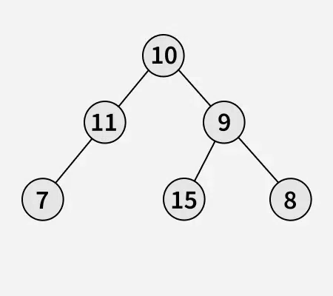
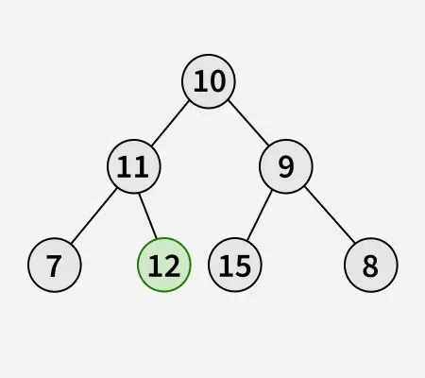
Input: key = 12

Slide 41
Deletion in a Binary Tree
The idea is to traverse the tree in level order manner. To perform the Deletion in a Binary Tree follow below:
Starting at the root, find the deepest and rightmost node in the binary tree and the node which we want to delete.
Replace the deepest rightmost node’s data with the node to be deleted.
Then delete the deepest rightmost node.

Slide 42
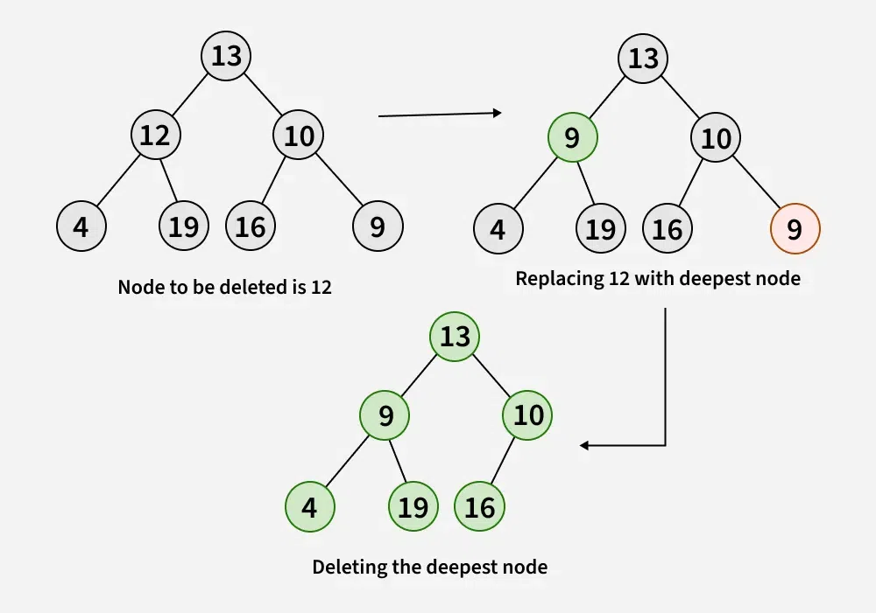

Slide 43
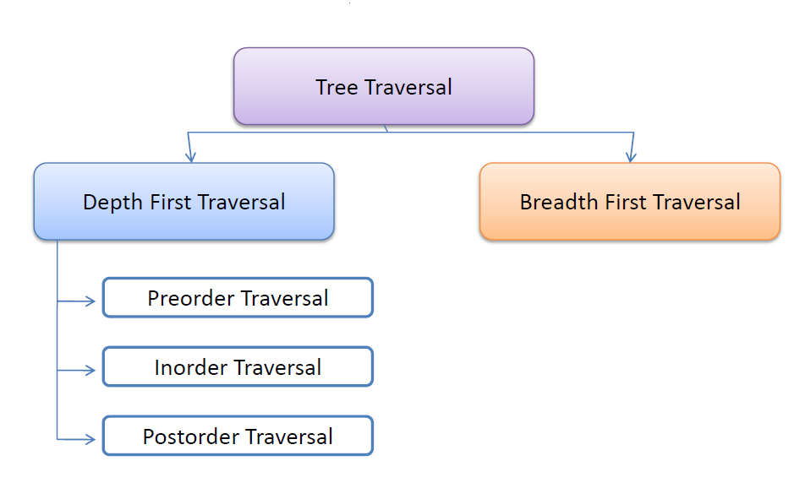
Binary Tree Traversals
Traversal means visit each node in the binary tree exactly once
There are three commonly used tree traversals
  Inoder Traversal
  Preorder Traversal
  Postorder Traversal

Slide 44
Tree Traversal
Used to visit each node in the tree exactly once
Three types of traversal
  Preorder
  Inorder
  Postorder

Slide 45
Tree Traversal
Three types of traversal
Preorder
» Visit root
» Visit left subtree in preorder
» Visit right subtree in preorder

Slide 46
Tree Traversal
Three types of traversal
Inorder
» Visit left subtree in inorder
» Visit root
» Visit right subtree in inorder

Slide 47
Tree Traversal
Three types of traversal
Postorder
» Visit left subtree in inorder
» Visit right subtree in inorder
» Visit root

Slide 48
Let L, V, and R stand for moving left, visiting the node/root, and moving right
  Inorder- LVR
  Postorder- LRV
  Preorder- VLR
52

Slide 49
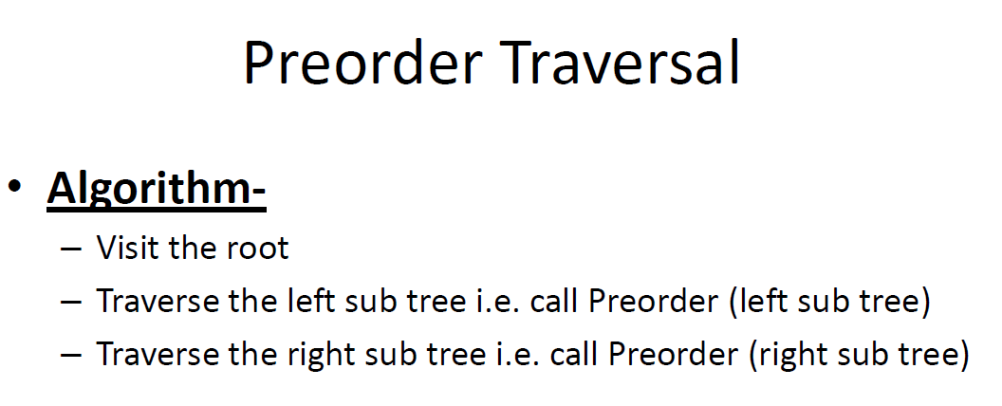

Slide 50
1-Preorder traversal
Algorithm PREORDER(root)
Input: root is the pointer to the root node of the binary search tree Output: Visiting of all the nodes in preorder fashion
Data structure: Linked structure Steps:
ptr=root
If(ptr!=NULL)
Code:
PREORDER(struct tree *ptr)
{
If(ptr!=NULL)
printf(“%d”,ptr->data); PREORDER(ptr->llink); PREORDER(ptr->rlink);
}
}
VISIT(ptr)
PREORDER(ptr->llink)
PREORDER(ptr->rlink)
// ptr=root
EndIf
Stop

Slide 51
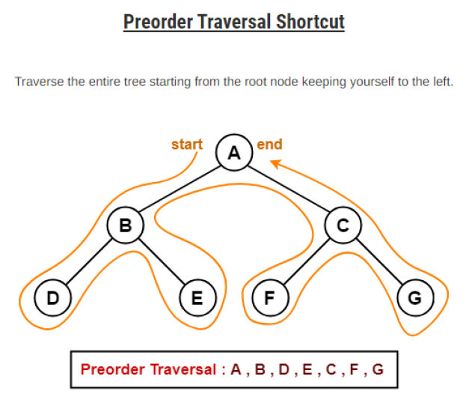

Slide 52
2-Inorder Traversal
Algorithm INORDER(root)
Input: root is the pointer to the root node of the binary search tree Output: Visiting of all the nodes in inorder fashion
Data structure: Linked structure
Steps:
ptr=root
If(ptr!=NULL)
  INORDER(ptr->llink)
  VISIT(ptr)
  INORDER(ptr->rlink)
3.
4.
EndIf
Stop

Slide 53
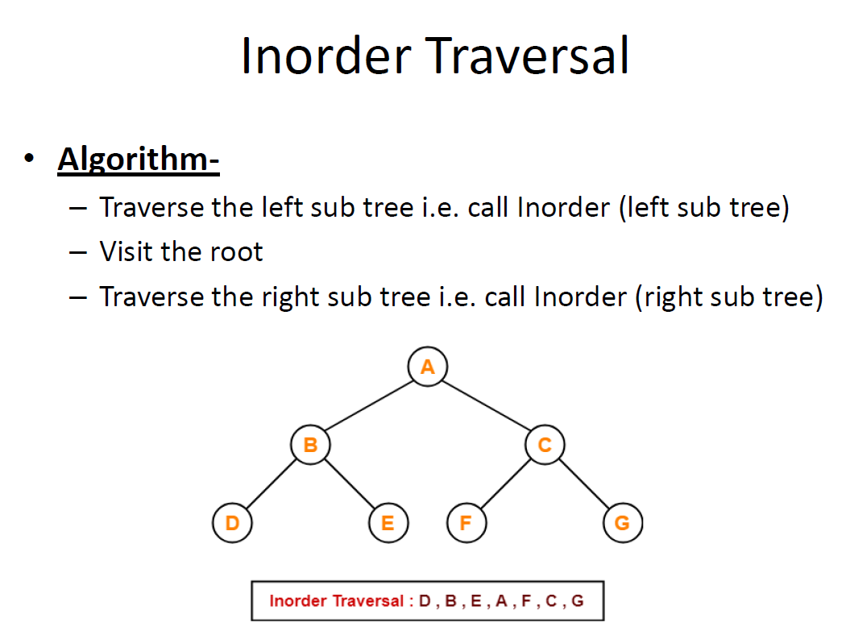

Slide 54
3-Postorder Traversal
Algorithm POSTORDER(root)
Input: root is the pointer to the root node of the binary search tree Output: Visiting of all the nodes in postorder fashion
Data structure: linked structure
Steps:
ptr=root
If(ptr!=NULL)
  POSTORDER(ptr->llink)
  POSTORDER(ptr->rlink)
  VISIT(ptr)
3.
4.
EndIf
Stop

Slide 55
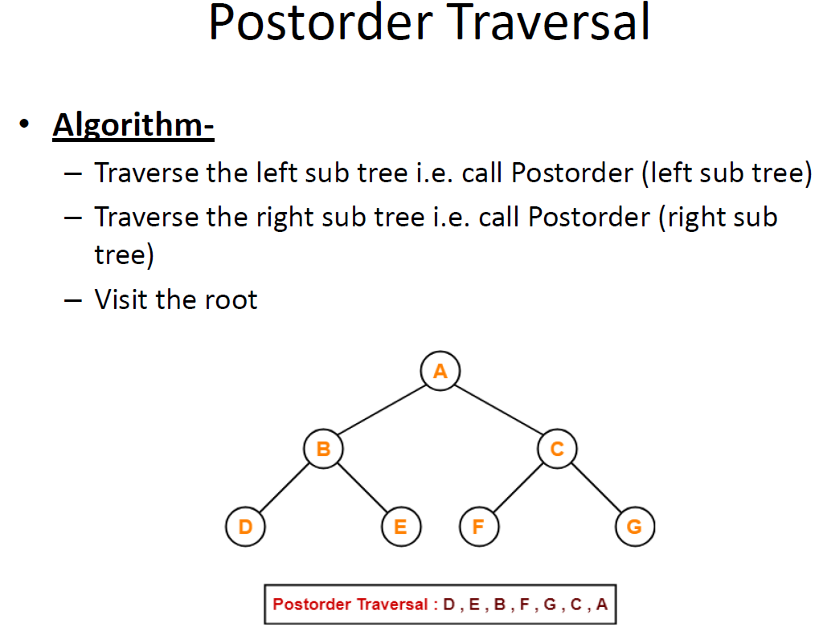

Slide 56
Question :
Write the preorder, inorder and postorder traversal of
5
Root
3
7
1
4
6
8
0
2
9

Slide 57
Answer:
PREORDER = 5 3 1 0 2 4 7 6 8 9
INORDER= 0 1 2 3 4 5 6 7 8 9 (sorted order)
POSTORDER= 0 2 1 4 3 6 9 8 7 5
3
Root
5
7
1
4
6
8
0
2
9

Slide 58
Construct tree from the inorder and preorder traversals
PREORDER = 5 3 1 0 2 4 7 6 8 9
INORDER= 0 1 2 3 4 5 6 7 8 9

Slide 59
Construct tree
from the following inorder and preorder traversals
PREORDER = 5 3 1 0 2 4 7 6 8 9
INORDER= 0 1 2 3 4 5 6 7 8 9
Preorder starts with the root
Now split the inorder traversal into 3 sets
– Left subtree, root, right subtree
Repeat the same process on each subtrees

Slide 60
PREORDER = 5 3 1 0 2 4 7 6 8 9
INORDER= 0 1 2 3 4 5 6 7 8 9
Root = 5
[01234] [5] [6789]
Root
0123456789

Slide 61
PREORDER = 5 3 1 0 2 4 7 6 8 9
INORDER= 0 1 2 3 4 5 6 7 8 9
Root = 5
[01234] [5] [6789]
Root
5
01234
6789

Slide 62
PREORDER = 5 3 1 0 2 4 7 6 8 9
INORDER= 0 1 2 3 4 5 6 7 8 9
Root
5
01234
6789

Slide 63
PREORDER = 5 3 1 0 2 4 7 6 8 9
INORDER= 0 1 2 3 4 5 6 7 8 9
Root
Root = 3
[012] [3] [4]
5
3
6789
012
4

Slide 64
PREORDER = 5 3 1 0 2 4 7 6 8 9
INORDER= 0 1 2 3 4 5 6 7 8 9
Root
5
3
6789
012
4

Slide 65
PREORDER = 5 3 1 0 2 4 7 6 8 9
INORDER= 0 1 2 3 4 5 6 7 8 9
Root
5
Root = 1
[0] [1] [2]
3
6789
No more elements to be divided In the left subtree
1
4
0
2

Slide 66
PREORDER = 5 3 1 0 2 4 7 6 8 9
INORDER= 0 1 2 3 4 5 6 7 8 9
Root
5
3
6789
1
4
0
2

Slide 67
PREORDER = 5 3 1 0 2 4 7 6 8 9
INORDER= 0 1 2 3 4 5 6 7 8 9
Root
Root =7
5
3
7
[6] [7] [89]
1
4
6
89
0
2

Slide 68
PREORDER = 5 3 1 0 2 4 7 6 8 9
INORDER= 0 1 2 3 4 5 6 7 8 9
Root
5
3
7
1
4
6
89
0
2

Slide 69
PREORDER = 5 3 1 0 2 4 7 6 8 9
INORDER= 0 1 2 3 4 5 6 7 8 9
Root
5
Root =8
[8] [9]
3
7
1
4
6
8
No more elements to be divided
In the right subtree
0
2
9

Slide 70
TYPES OF BINARY TREE
Expression tree
Binary search tree
Heap tree
Height balanced tree (AVL tree)

Slide 71
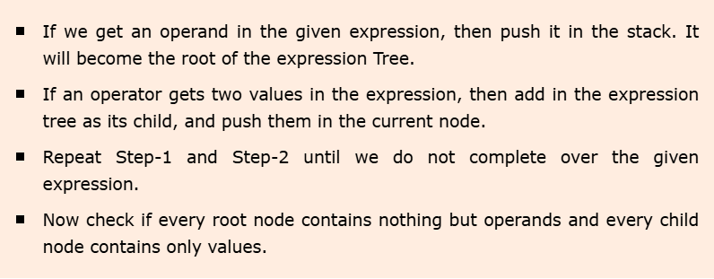
1. Expression Tree
An expression tree is a binary tree in which each internal node corresponds to the operator and each leaf node corresponds to the operand.

Slide 72
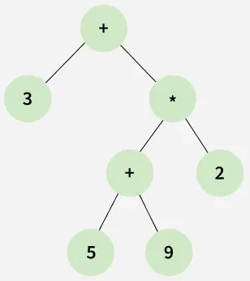
3 + ((5 + 9) * 2)

Slide 73
2. BINARY SEARCH TREE
A Binary search tree is a binary tree, such that
It may be empty
If it is not empty, then it satisfies the following properties:
  Every element has a key and no two elements have the same key (no duplicates)
  The keys (if any) in the left subtree are smaller than the key in the root
  The keys (if any) in the right subtree are larger than the key in the root
  The left and right subtrees are also binary search trees

Slide 74
Binary Search Trees
K
Keys < K
Keys> K

Slide 75
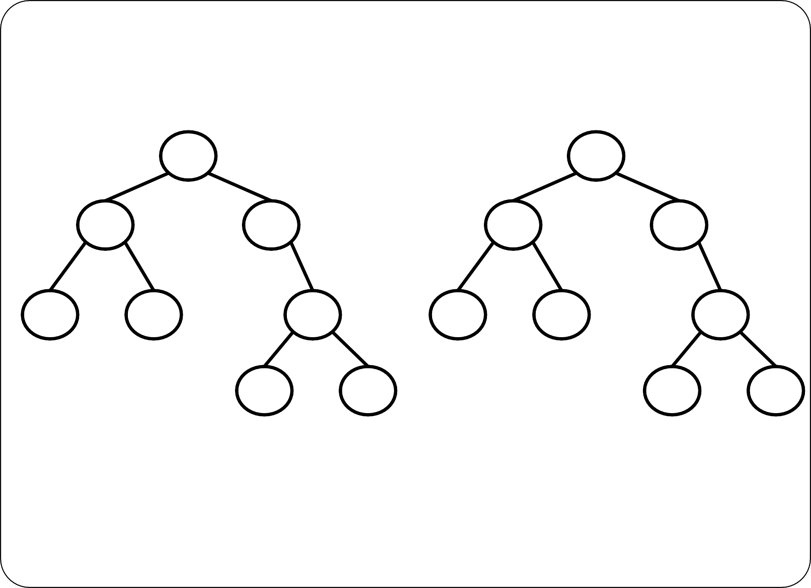
Binary Search Trees
5
5
3
6
3
6
1
4
8
1
2
9
7
9
7
8
Binary Search Tree
Not a Binary Search Tree

Slide 76
Binary Search Trees
5
3
6
1
4
8
7
9
Inorder Traversal: 1 3 4 5 6 7 8 9
Inorder traversal of BST generate a sorted list

Slide 77
Operations on Binary Search Trees
Four operations
  Searching
  Insertion
  Deletion
  Traversal
The time complexity of searching, insertion and deletion = O(h)
where h is the height of the tree.

Slide 78
Binary Search Trees: Searching
Let item is the value to be searched
Search begins at root
If root is NULL search unsuccessful
Else compare item with root
If item is less than root then only the left sub tree is to be searched. The sub tree may be searched recursively
If item is greater than root then only the right sub tree is to be searched. The sub tree may be searched recursively

Slide 79
Binary Search Trees: Searching
30
20
65
Search 68
10
24
50
80
45
70
90
68
66
69

Slide 80
Binary Search Trees: Searching
30
20
65
Search 68
10
24
50
80
45
70
90
68
66
69

Slide 81
Binary Search Trees: Searching
30
20
65
Search 68
10
24
50
80
45
70
90
68
66
69

Slide 82
Binary Search Trees: Searching
30
20
65
Search 68
10
24
50
80
45
70
90
68
66
69

Slide 83
Binary Search Trees: Searching
30
20
65
Search 68
10
24
50
80
45
70
90
68
66
69

Slide 84
Binary Search Trees: Searching
30
20
65
Search 68
10
24
50
80
45
70
90
68
66
69

Slide 85
Binary Search Trees: Searching
30
20
65
Search 68
Search Data Found
10
24
50
80
45
70
90
68
66
69

Slide 86
Binary Search Trees: Searching
30
20
65
Search 25
10
24
50
80
45
70
90
68
66
69

Slide 87
Binary Search Trees: Searching
30
20
65
Search 25
10
24
50
80
45
70
90
68
66
69

Slide 88
Binary Search Trees: Searching
30
20
65
Search 25
10
24
50
80
45
70
90
68
66
69

Slide 89
Binary Search Trees: Searching
30
20
65
Search 25
10
24
50
80
45
70
90
68
66
69

Slide 90
Binary Search Trees: Searching
30
20
65
Search 25
Search Data Not Found
10
24
50
80
45
70
90
68
66
69

Slide 91
Algorithm BST_Search(item)
ptr=root
flag=0
While ptr!=NULL and flag=0 do
  If ptr→data=item then
    flag=1
    Else if item>ptr→data then
      ptr=ptr→rChild
    Else
      ptr=ptr→lChild
    If flag=1 then
      Print “Search data found”
    Else
      Print “Search data not found”

Slide 92
Binary Search Trees: Insertion
Suppose "item" is to be inserted in the BST
Search for item
If item is found then do nothing
Else the item is inserted as left or right child where the search halts

Slide 93
Algorithm BST_Insertion(item)
If ROOT=NULL then
  Create a node new and insert item in to it. Set it as ROOT node
  Else
    Search item in the tree
    If search data found, insertion is not possible
    Else
      Find the parent node in which the item is to be inserted
      Create a node new and insert item in to it.
      If item<parent→data then
        Insert new as the left child of parent
      Else
        Insert new as the right child of parent

Slide 94
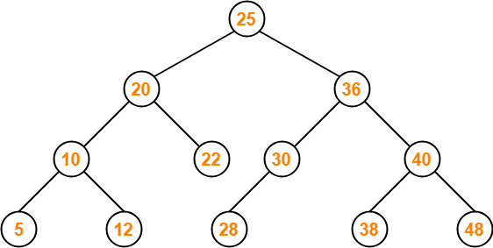
Binary Search Tree construction
In a binary search tree (BST), each node contains:
  Only smaller values in its left sub tree
  Only larger values in its right sub tree

Slide 95

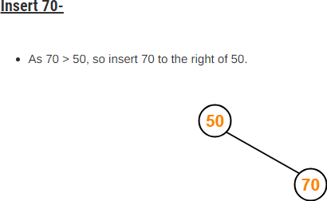
Example
Construct a Binary Search Tree (BST) for the following sequence of numbers:
50, 70, 60, 20, 90, 10, 40, 100
When elements are given in a sequence,
  Always consider the first element as the root node.
  Consider the given elements and insert them in the BST one by one.

Slide 96
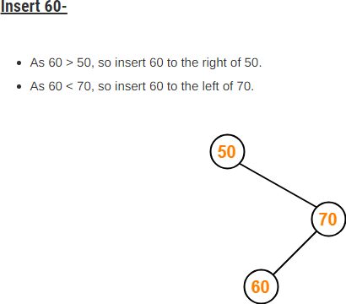
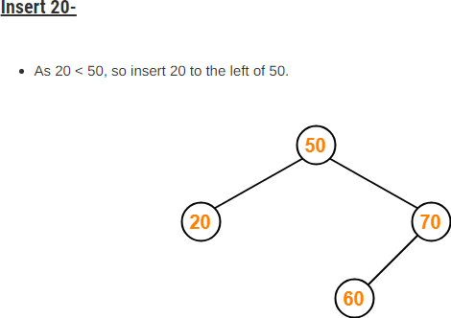

Slide 97
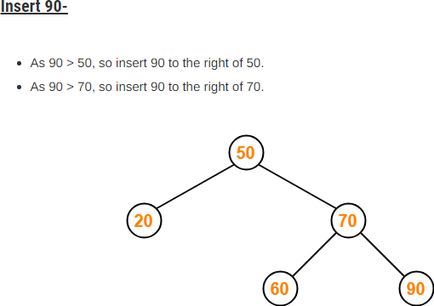
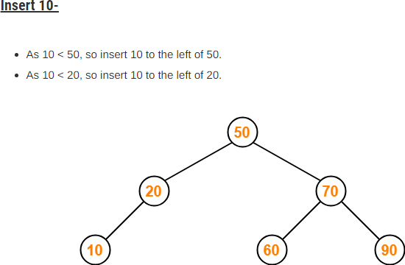

Slide 98
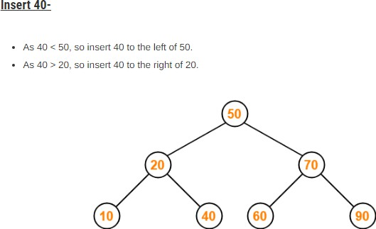
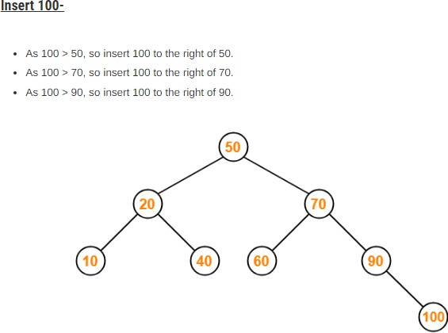

Slide 99

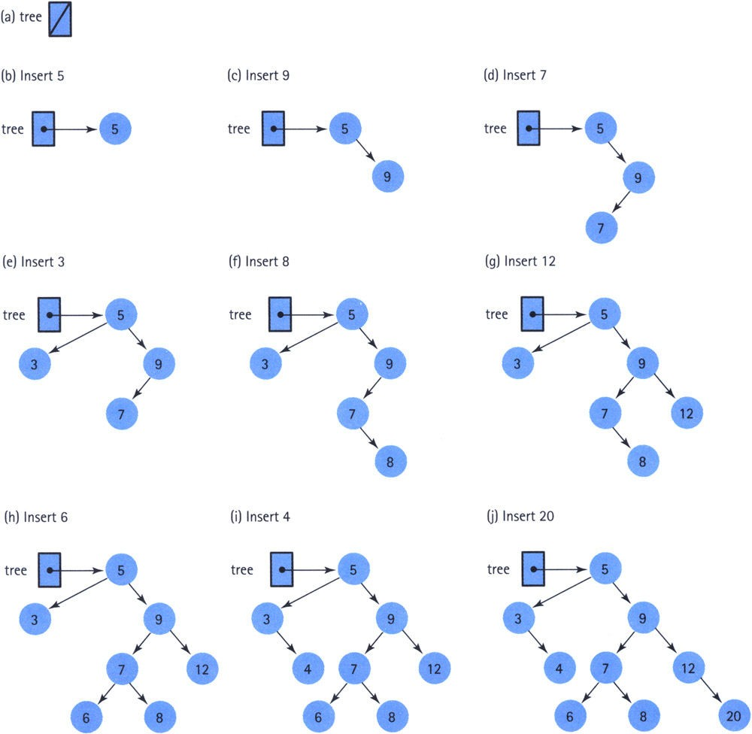



Slide 100
Binary Search Trees: Deletion

Slide 101
Deletion Operation
Deletion Operation is performed to delete a particular element from the Binary Search Tree.
When it comes to deleting a node from the binary search tree, three cases are possible.

Slide 102
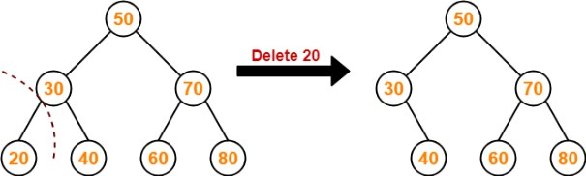
Case-01: Deletion Of A Node Having No Child (Leaf Node)
Just remove / disconnect the leaf node that is to deleted from the tree.

Slide 103
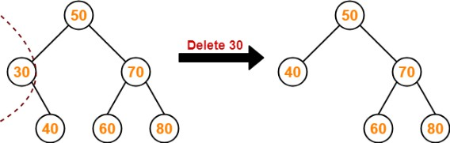
Case-02: Deletion Of A Node Having Only One Child
Consider the following example where node with value = 30 is deleted from the BST.

Slide 104
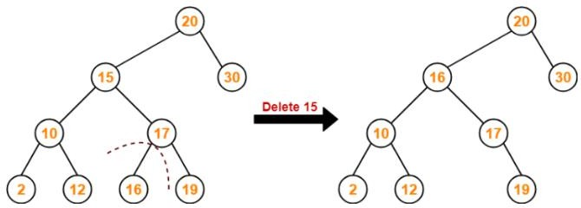
Case-03: Deletion Of A Node Having Two Children
Consider the following example where node with value = 15 is deleted from the BST
Method-1:
  Visit to the right subtree of the deleting node.
  Pluck the least value element called as inorder successor.
  Replace the deleting element with its inorder successor.

Slide 105
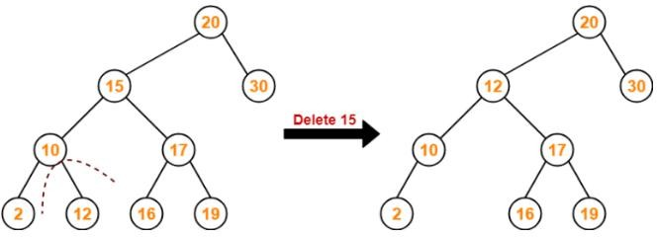
Method-2:
  Visit to the left subtree of the deleting node.
  Pluck the greatest value element called as inorder successor.
  Replace the deleting element with its inorder successor.

Slide 106
Binary Search Trees: Deletion
Algorithm BST_Deletion()
Let x be a node to be deleted
If x is a leaf node then
  Delete x
Else if x is a node with only one child then
  Replace x with the child node of x
  Delete x
Else if x having two children then
  Find the inorder successor/predecessor of x, say y
  Find the right/left child of y, say z
  Copy the data from y to x
  Replace y by z

Slide 107
Binary Search Trees: Deletion
Case 1: x is a leaf node
Delete x
30
30
Delete 15
Case 1
5
40
5
40
2
15
x
2
80
80

Slide 108
Binary Search Trees: Deletion
Case 2: x is a node with only one child
Replace x with the child node of x
Delete x
30
30
Delete 40
Case 2
x
5
40
5
80
2
80
2
70
90
70
90

Slide 109
Case 3: x having two children
Find the inorder successor, say y
Find the right, say z
Copy the data from y to x
Replace y by z
30
20 60
24 50
Delete 60
10
80
45
70
90
65
68
66
69

Slide 110
Case 3: x having two children
Find the inorder successor, say y
Find the right, say z
Copy the data from y to x
Replace y by z
30
x
20 60
24 50
Delete 60
10
80
45
70
90
y
65
68
z
66
69

Slide 111
Case 3: x having two children
Find the inorder successor, say y
Find the right, say z
Copy the data from y to x
Replace y by z
30
x
20 65
24 50
Delete 60
10
80
45
70
90
y
65
68
z
66
69

Slide 112
Case 3: x having two children
Find the inorder successor, say y
Find the right, say z
Copy the data from y to x
Replace y by z
30
x
20 65
24 50
Delete 60
10
80
45
70
90
68 z
66
69

Slide 113
Binary Search Trees: Applications
Remove duplicate values
  Consider a collection of n data items A₁,A₂, …, A_{N}. Suppose we want to find and delete all duplicates in the collection. Then, we can represent them as BST and remove the duplicate values, while it occurs.
Find the smallest data- Traverse the left subtree of BST
Find the largest data- Traverse the right subtree of BST
Find a particular data- Traverse the whole BST

Slide 114
3. AVL Tree
An AVL(Adelson-Velskii and Landis) tree is a self-balancing binary search tree in Data structure
Characteristics
BST : Left child < Parent <Right child
Self-Balancing :Ensures tree remains balanced
Height-Balanced : For each node in tree the difference between
|height of left subtree| - |height of right subtree| = {-1,0,1}
This difference is Balance Factor

Slide 115
Example
Suppose we have x, y, z
x
0
Balance Factor

Slide 116
Example
Suppose we have x, y, z
Left subtree – right subtree
0-1 =-1
x
y
0

Slide 117
Example
Suppose we have x, y, z
x
0 – 2 = -2
y
0 – 1 = -1
z
0
Tree is not balanced

Slide 118
Rotating the subtrees in an AVL Tree:
An AVL tree may rotate in one of the following four ways to keep itself balanced:
Left Rotation
Right Rotation
Left-Right Rotation
Right-Left Rotation

Slide 119
Left Rotation
When a node is added into the right subtree of the right subtree, if the tree gets out of balance, we do a single left rotation
Suppose we have x, y, z
1-1=0
y
x
0 – 2 = -2
x
y
0 – 1 = -1
y
z
0
x
z
0
0
z
Left Rotation
Tree is not balanced

Slide 120
Right Rotation
If a node is added to the left subtree of the left subtree, the AVL tree may get out of balance, we do a single right rotation.
Suppose we have z, y, x
2
z
z
1-1=0
y
y 0 – 1 = -1
y
z
0
x
0
x
x
0
Tree is not balanced
Right Rotation

Slide 121
Left Right Rotation
A left-right rotation is a combination in which first left rotation takes place after that right rotation executes.
Suppose we have z, x, y
2
z
z
-2
1-1=0
y
x
0 – 1 = -1
y
1
z
0
x
y
0
x
0
0
Left Rotation & Right Rotation
Tree is not balanced

Slide 122
Right Left Rotation
A right-left rotation is a combination in which first right rotation takes place after that left rotation executes.
Suppose we have x, z, y
2
x
1-1=0
y
x
z
1-0=1
y
z
0
x
0
y
z
0
Tree is not balanced
Right Rotation

Slide 123
Example 2
Suppose you have A , B , C create a balanced AVL with the help of different Rotations

Slide 124
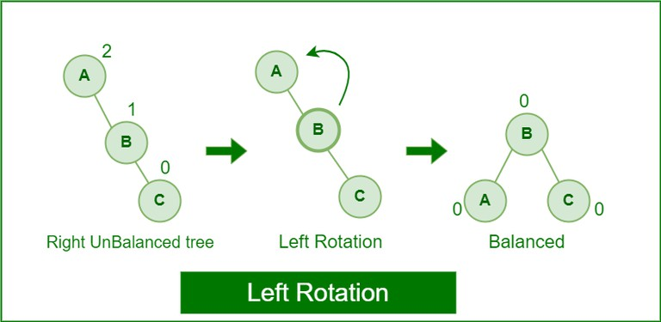

Slide 125
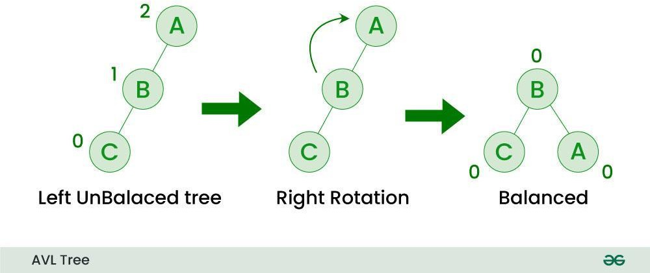

Slide 126
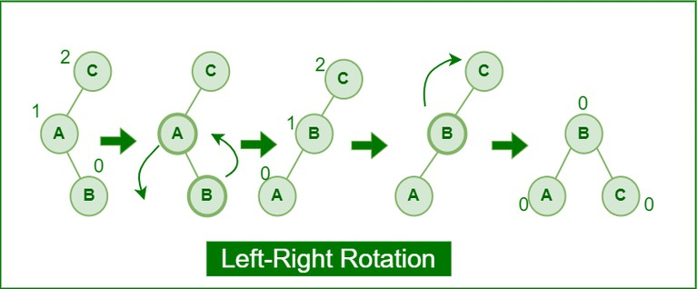

Slide 127
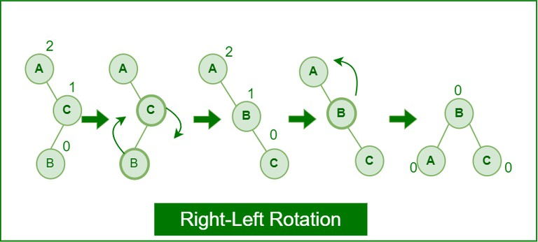

Slide 128
AVL Tree Operations
Insertion
Deletion
Searching

Slide 129
Applications of AVL Trees:
Databases and File Systems: Used to implement B-trees and other balanced tree structures.
Symbol Tables: Used to store and retrieve symbols in compilers and interpreters.
Network Routing: Used in routing algorithms to efficiently store and retrieve routing information

Slide 130
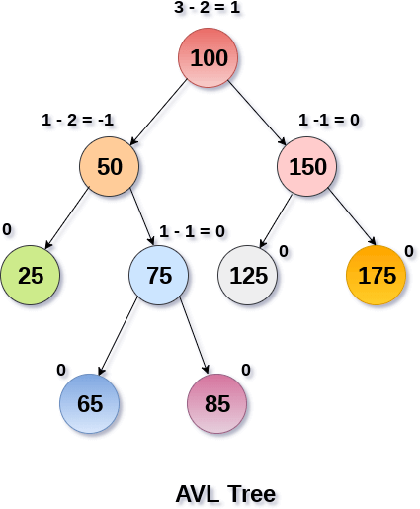
Balanced AVL Tree

Slide 131
HEAP Tree
heap is a complete binary tree, and the binary tree is a tree in which the node can have utmost two children.
complete binary tree is a binary tree in which all the levels except the last level, i.e., leaf node should be completely filled, and all the nodes should be left-justified.

Slide 132
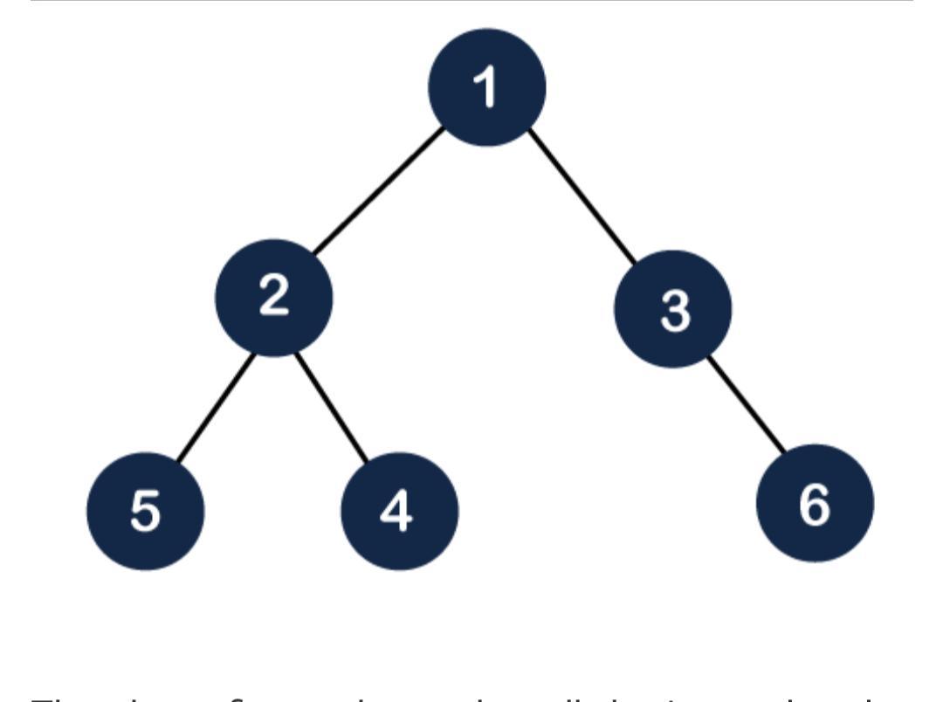
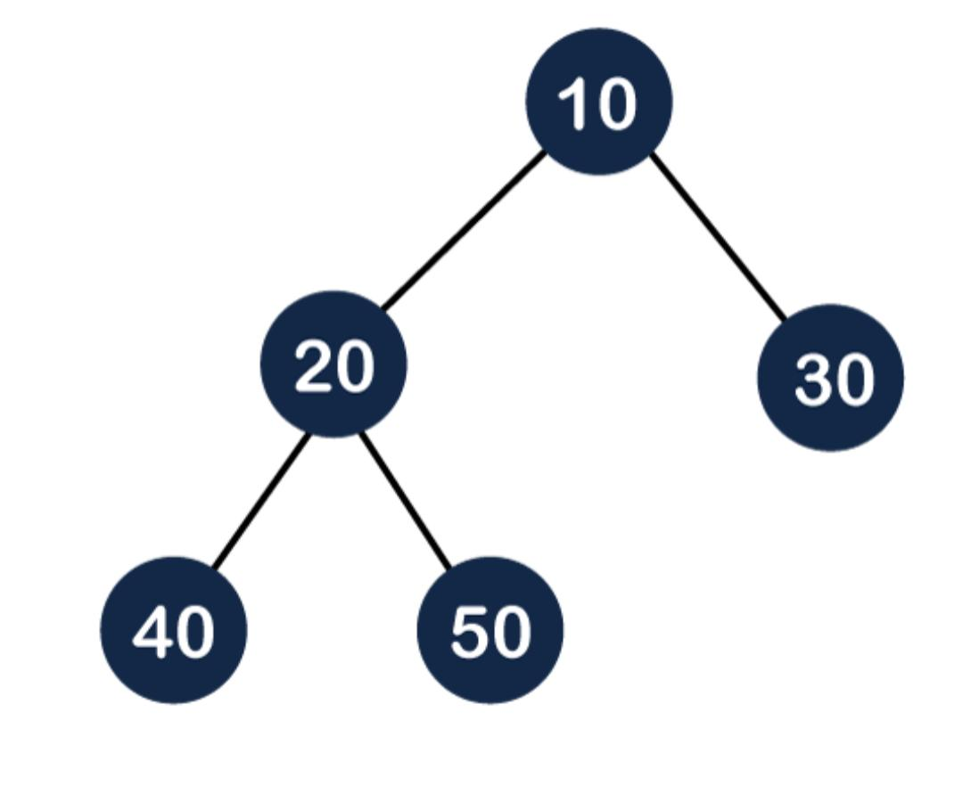
HEAP Tree

Slide 133
HEAP Tree
Heaps can be of two types:
Max-Heap: In a Max-Heap the key present at the root node must be greatest among the keys present at all of it’s children. The same property must be recursively true for all sub-trees in that Binary Tree.
Min-Heap: In a Min-Heap the key present at the root node must be minimum among the keys present at all of it’s children. The same property must be recursively true for all sub-trees in that Binary Tree.

Slide 134
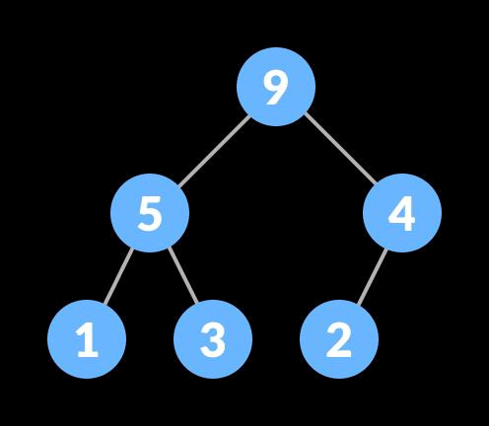
MAX HEAp

Slide 135
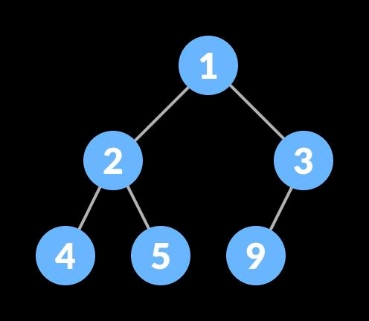
Min heap

